Slide 1
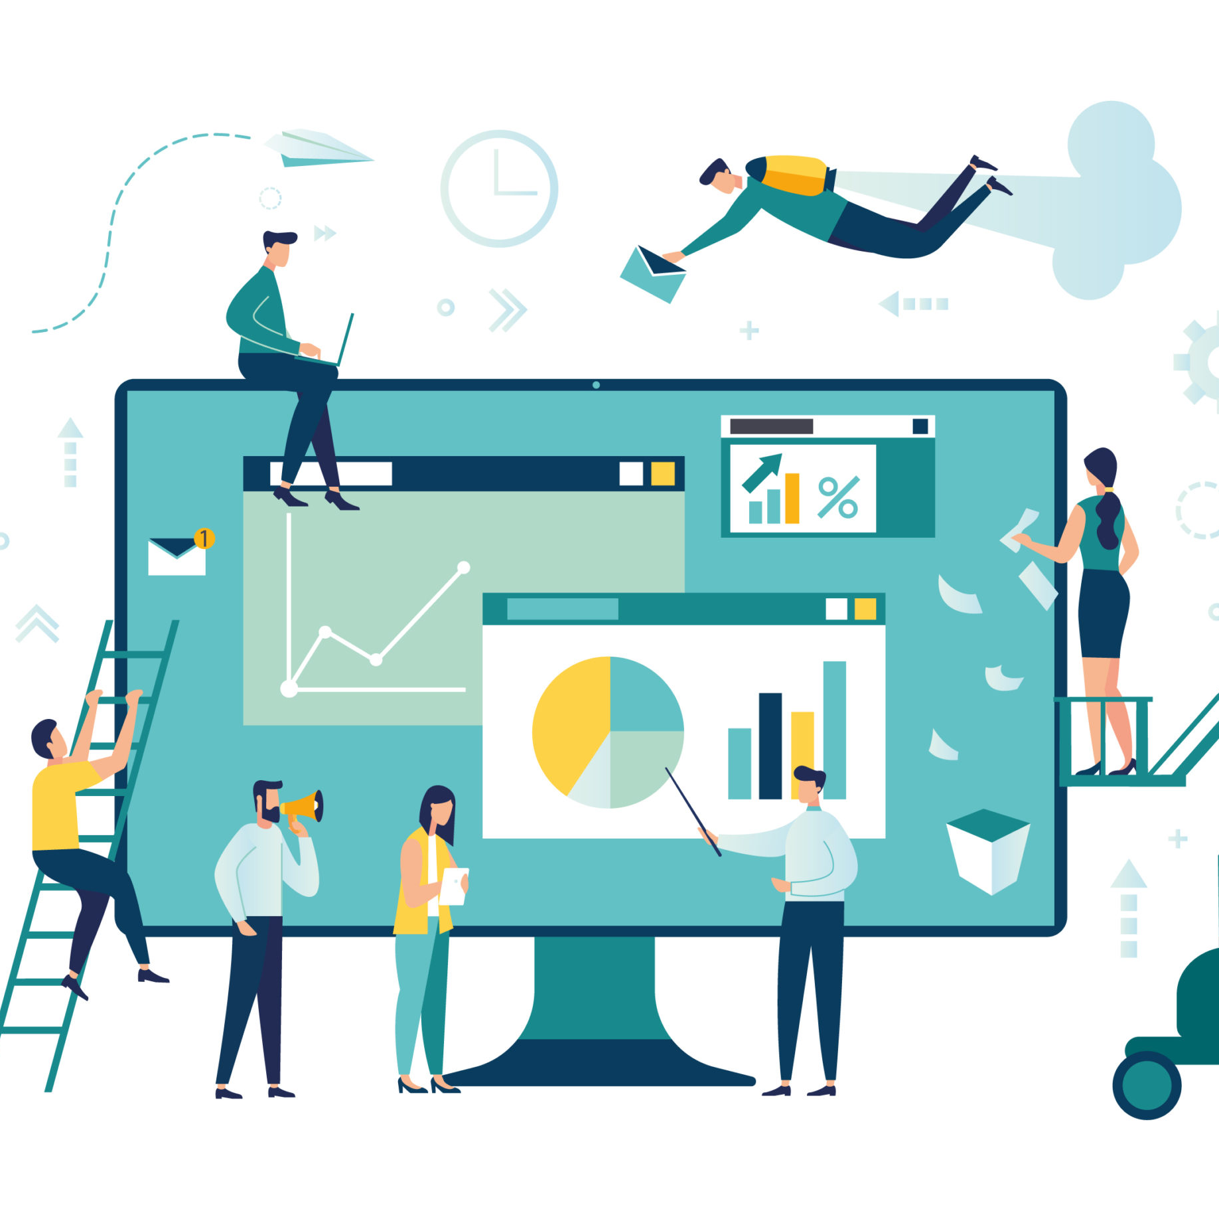
Customer Segmentation – Product Analytics
Customer engagement plays a pivotal role in consumer retention in any product. Specifically in a Fin-Tech eco-system, Capturing consumer information and tailoring detailed insights for different customers is a key factor in various aspects.
Classifying customers into segments which in turn will be used to target tailored campaigns to appropriate customers.
Data – Demographic and Financial records of customers such as Age, Annual Income, Gender, Spending score shall be used to segment customers accordingly.
Use of ML clustering models to perform the classification on huge customer data.
Model Deployment - Streamlit (Local) - Heroku (Cloud)

Slide 2
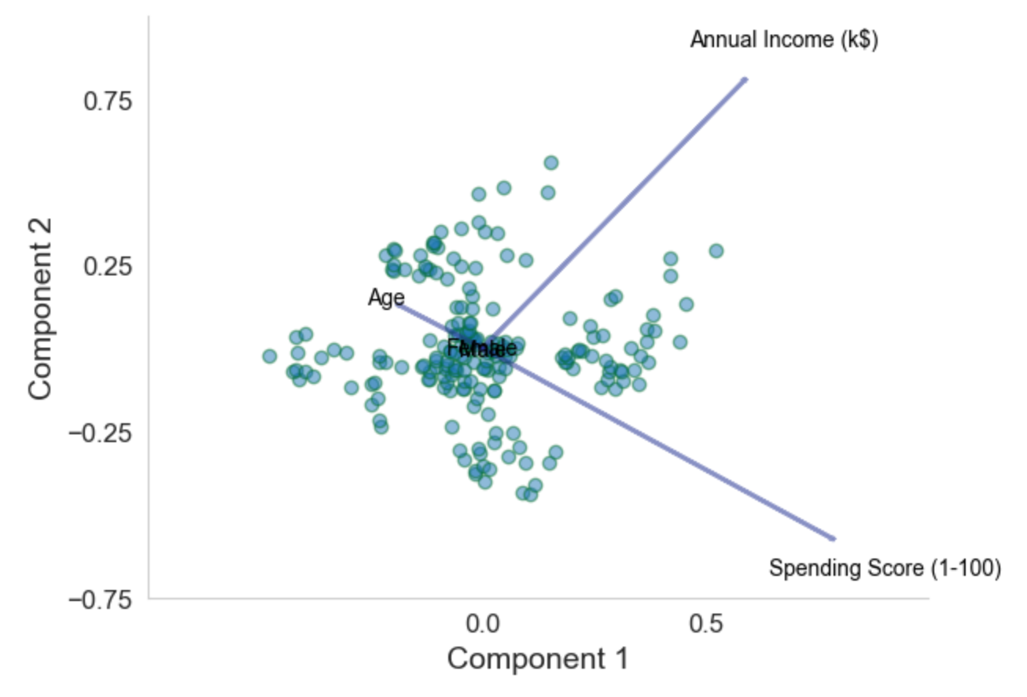
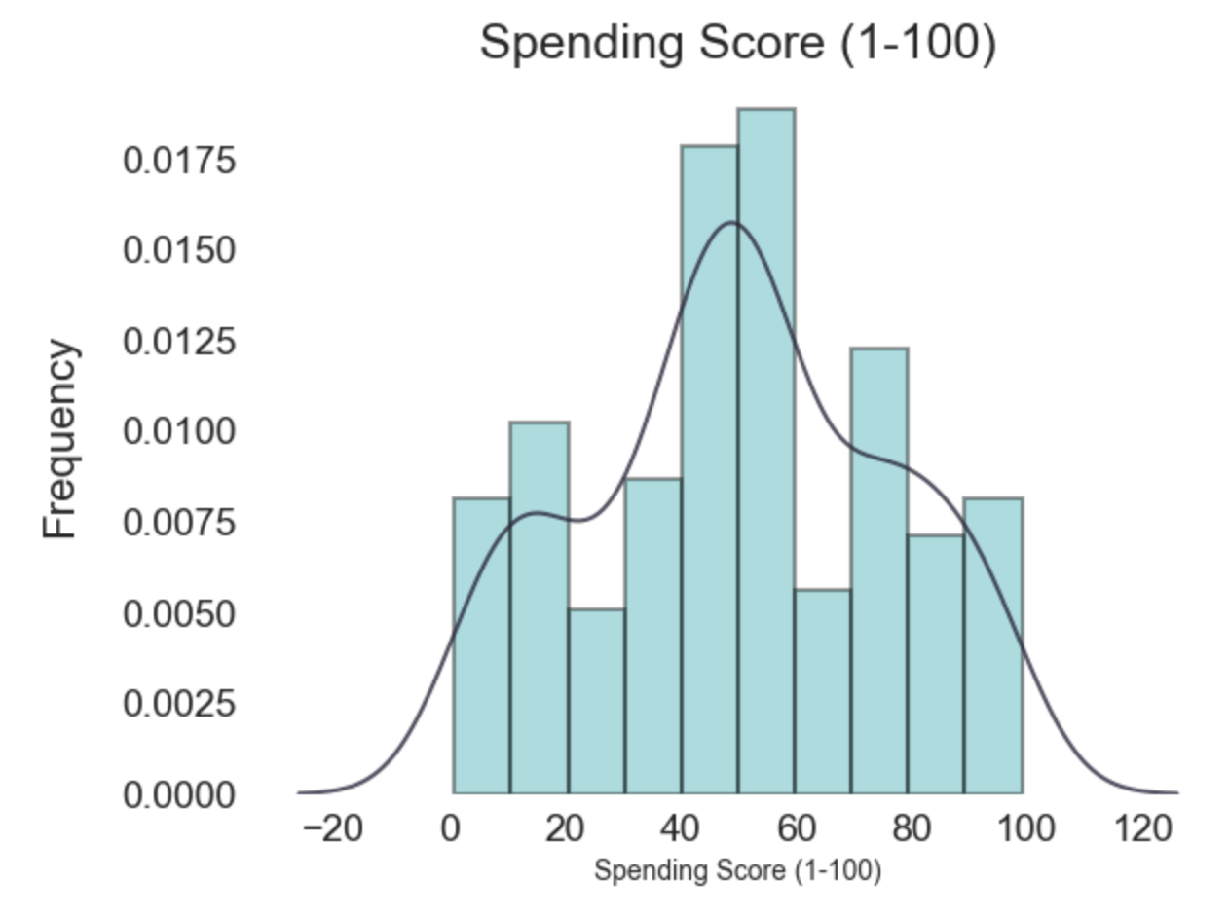
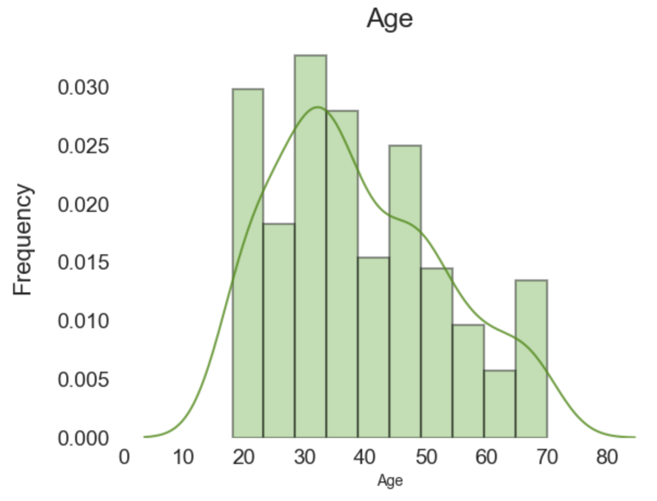
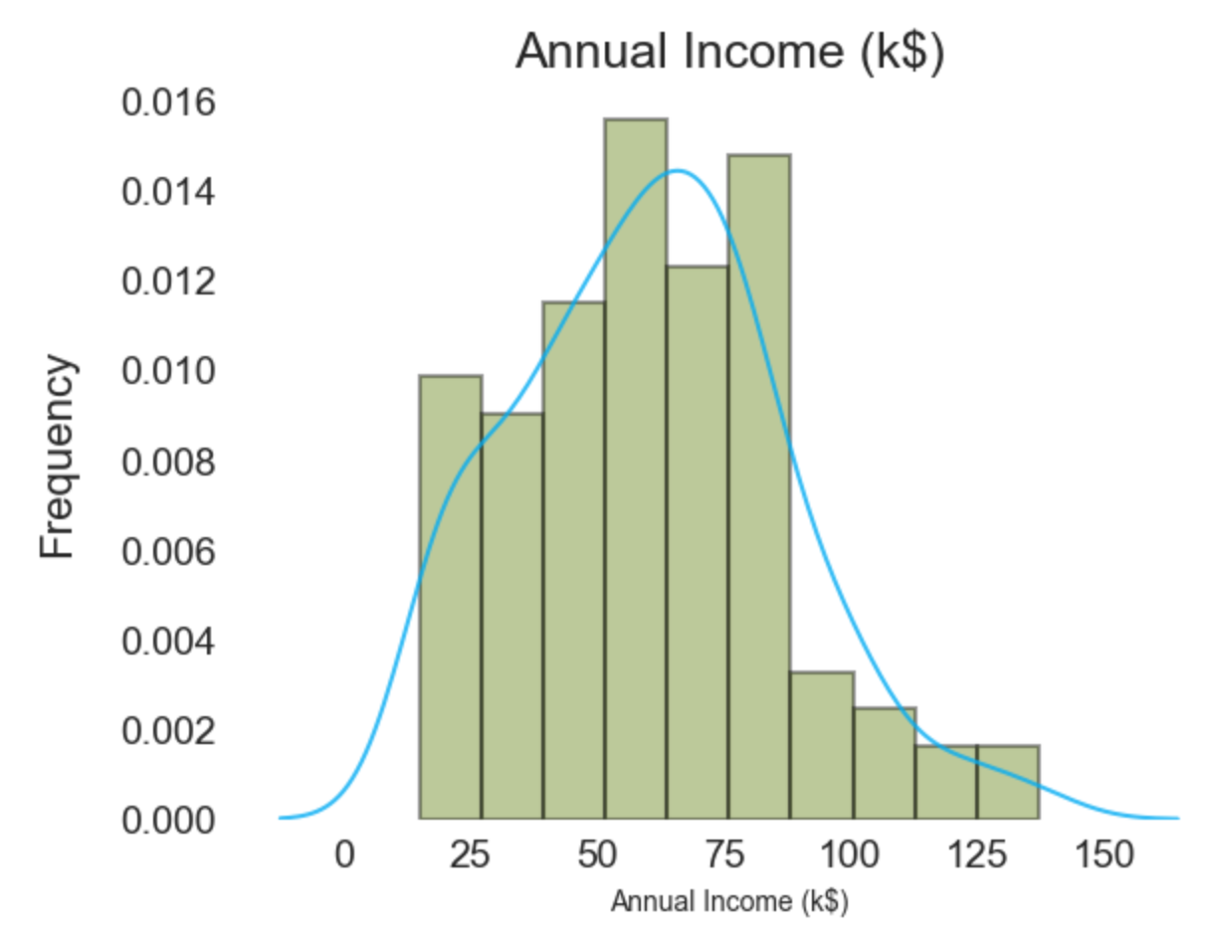
Customer Segments
Key Features
Segment 0 - Low Income - Low Spending segment
Segment 1 - High Income - High Spending segment
Segment 2 - Average Income - Average Spending segment
Segment 3 - High Income - Low Spending segment
Segment 4 - Low Income - High spending segment
Data-Sights

Slide 3
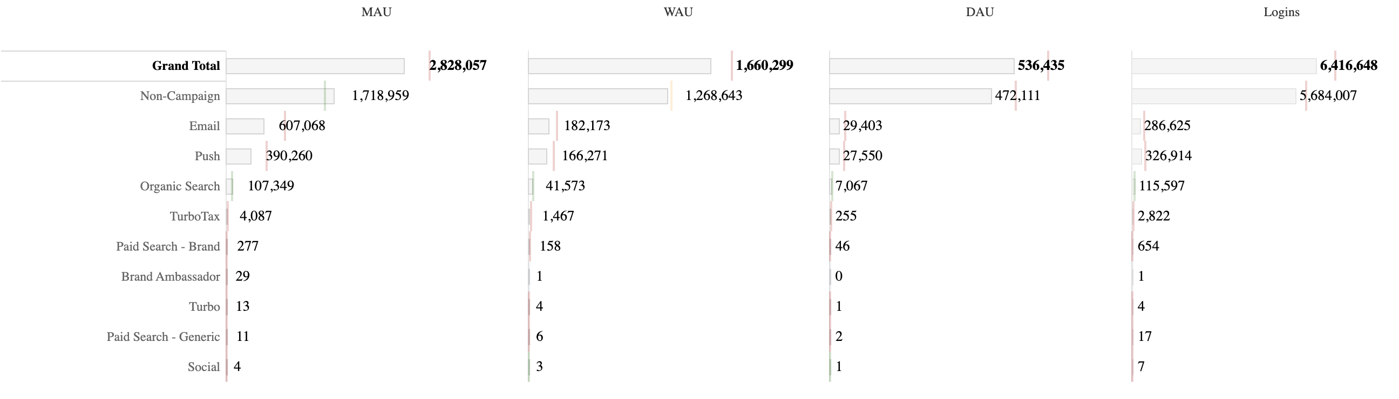
Business scope
20+ insights like Category_spend, Payment streak, Mobile_Bill increase etc.., are being sent as mail alerts and push notifications to customers at different periodic intervals.
Segmenting customers will help us target the right customers with appropriate alerts and notifications.

Slide 4
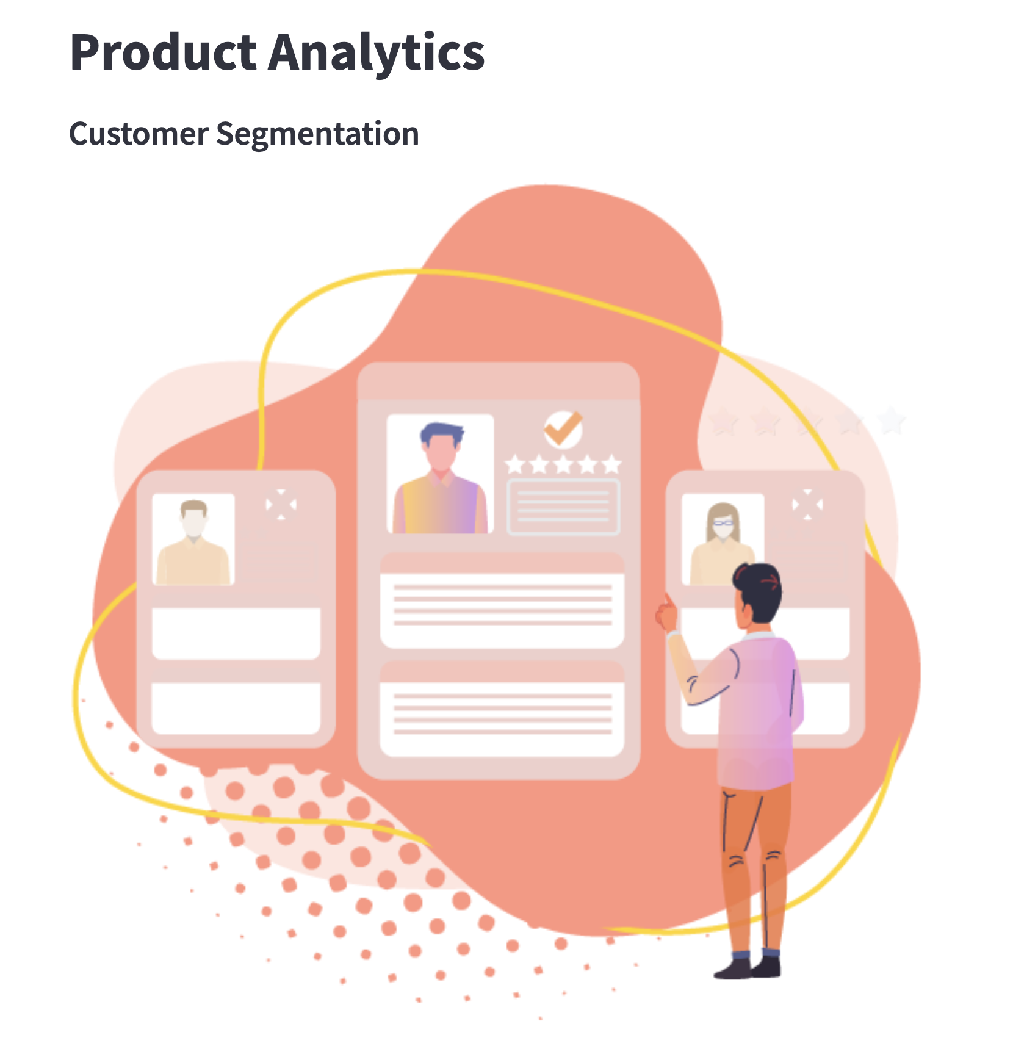
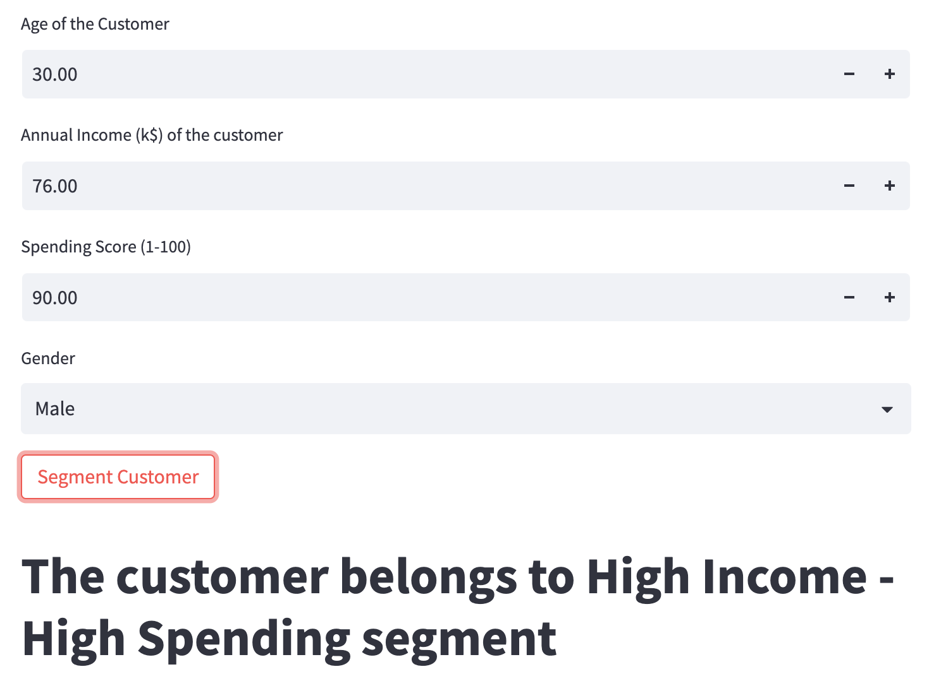
Prototype

